Slide 1
Throwing Balls and other stuff
David Giandomenico December 13, 2014

Slide 2
Talk Overview
Physics
Math
More Physics
Projectile Trajectory
Momentum transfer
Linear Momentum
Angular Momentum
Moments of inertia
Grip forces
Kinetic energy of rotating parts

Slide 3
FIRST Games with Shooting
☑ 2014: Aerial Assist – Shoot 2ft / 3lb exercise balls
☑ 2013: Ultimate Ascent – Launch Frisbee®s
☑ 2012: Rebound Rumble – Shoot solid foam balls
☐ 2011: Logomotion – Handle inflatable shapes
☑ 2010: Breakaway – Kick soccer balls
☑ 2009: Lunacy – Shoot “orbit” balls
☑ 2008: FIRST Overdrive – Lift or shoot large exercise balls
☐ 2007: Rack 'n Roll – Handle inflatable rings; Lift robots
☑ 2006: Aim High – Shoot solid foam balls
☐ 2005: Triple Play – Move large tetrahedrons
☐ 2004: FIRST Frenzy: Raising the Bar – Move medium & large balls

Slide 4
Types of Launchers
Energy Transfer
Example: Release of a spring like a catapult
Momentum Transfer
Example: Bat & ball, or Flywheel tennis ball launcher
Constant Force Transfer
Example: Constant friction drive wheel
Notes:
If you don’t know, you may not be able to characterize your launcher, to solve inconsistent shooting problems.

Slide 5
Find the Requirements
Projectile
Kinematics – motion of the object
Launch energy of Projectile
Machine
Momentum & energy transfer
Energy losses during launch
Total input energy required

Slide 6
Specify the Target Trajectory

Slide 7
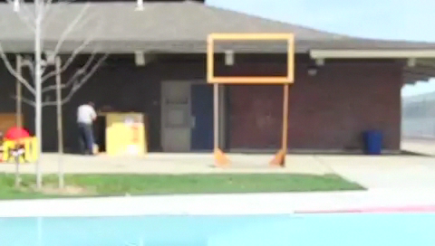
Verify the trajectory is parabolic
Notes:
In many competitions, there is concern that “windage” may influence the trajectory.

Slide 8
Track trajectory using Kinovea
Open source software freely available at: http://www.kinovea.org/
Notes:
Using free software “Kinovea”, you can see the trajectory. At an early stage of the competition, the trajectory can be verified, even without a robot.

Slide 9
Trajectory is Parabolic ✓
Observed vs Measured Trajectory
–– Measured
–– Desired
–– Parabolic fit (quadratic)

Slide 10
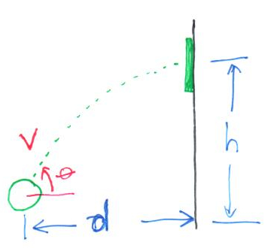
Game Requirement ( an example )
Solid foam ball
Mass: 0.5 Kg ( a little more than 1 lb )
Height to target: 2m ( a little more than 6ft)
Distance to target: 3m minimum
Target is vertical on wall

Slide 11
Kinematics

Slide 12
Find Launch Velocity V and Angle

Slide 13
Find Launch Velocity V and Angle

Slide 14
Find Launch velocity V and angle

Slide 15
Find Launch velocity V and angle
Divide:

Slide 16
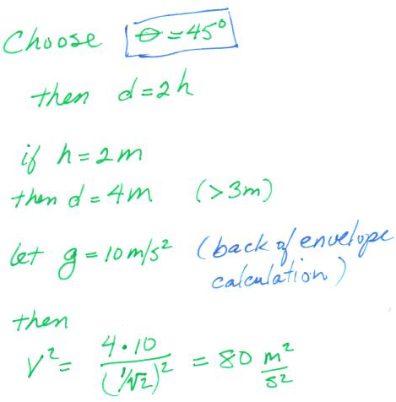
Launch Velocity: Example Calculation

Slide 17
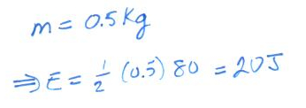
Kinetic Energy ( Translational ) Example Calculation
Revisit this later to add rotational energy...

Slide 18
Power Limitations
Estimate: If our motor system can deliver 150W with 100% efficiency, how long will it take, and how far will our projectile travel as we accelerate constantly from 0 to our target V?
assume constant acceleration†
Our Example:
†Acceleration will not be constant, but this is still close enough.
Notes:
Constant acceleration is not consistent with constant power, but this estimate still serves to illustrate the point.
More carefully, d = (2/3) V t, since the speed rises faster than linear, but Force is infinite at t=0 for constant power.

Slide 19
Power Limitation - Conclusion
Launch mechanism will probably not fit in our robot.
Instead release stored energy over a short time.
†Acceleration will not be constant, but this is still close enough.
Notes:
Constant acceleration is not consistent with constant power, but this estimate still serves to illustrate the point.
More carefully, d = (2/3) V t, since the speed rises faster than linear, but Force is infinite at t=0 for constant power.

Slide 20



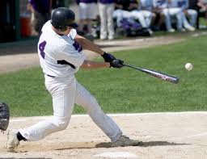
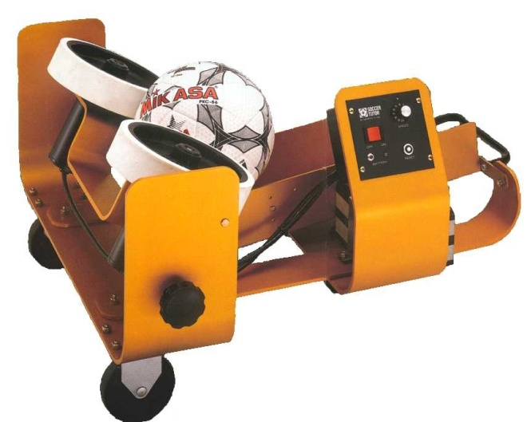
Which of These Things Doesn’t Belong?
(B)
(A)
(D)
(E)
(C)

Slide 21
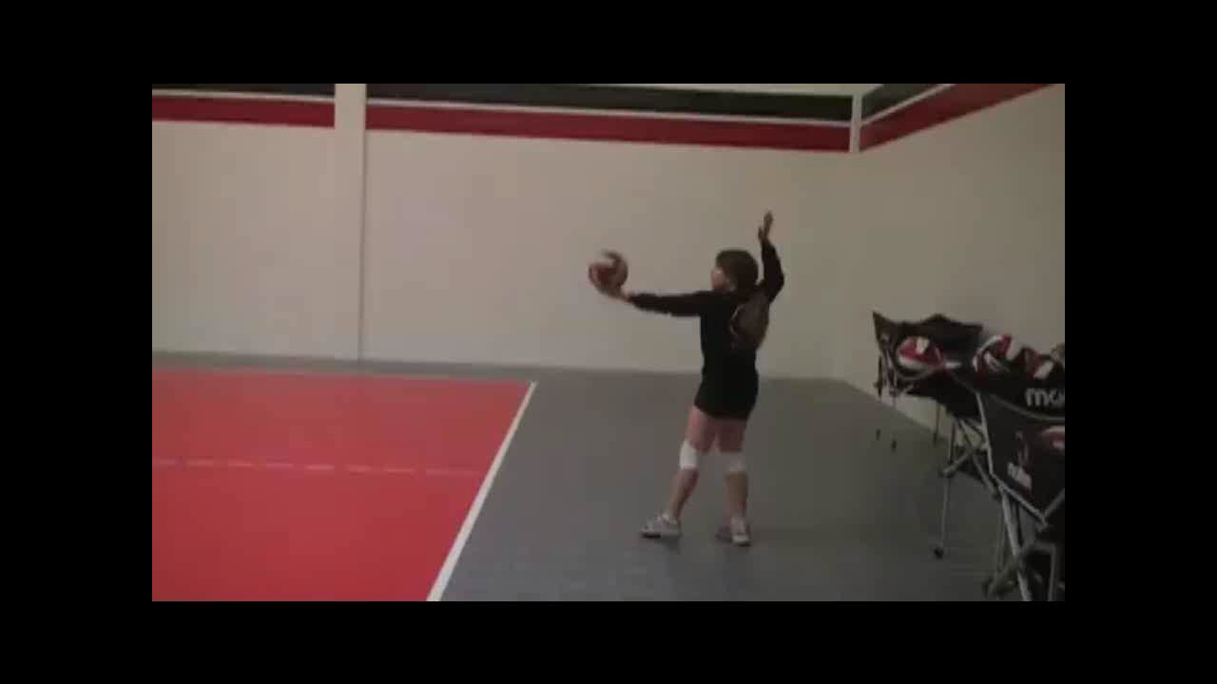
Jessica. 29 MPH float serve in slow motion. California Heat Volleyball Club Uploaded by: GenjitsuDojo
Notes:
Add video

Slide 22

Golf impact – Slow Motion Video Uploaded by: BiomechanicsMMU
Notes:
Add video

Slide 23

Tim Linecum pitching in slow motion – Red Bull Moments Uploaded by: redbull
Notes:
Add video

Slide 24

Barry Harper batting form –slow motion
Uploaded by: Gus M
Notes:
Add video

Slide 25
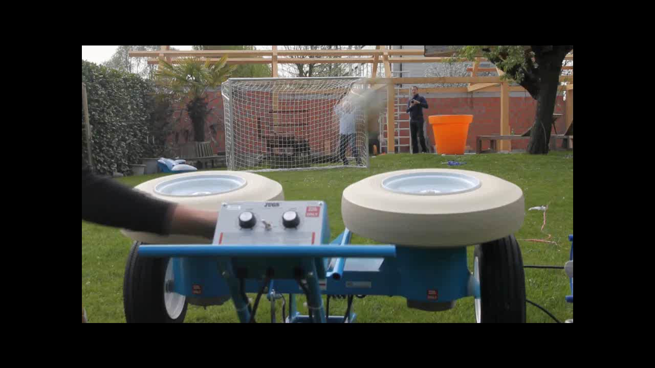
Another phenomenon…

Slide 26
Which of These Things Doesn’t Belong?
(B)
(A)
(D)
(E)
(C)

Slide 27
Which of These Things Doesn’t Belong?
Pitching requires all energy to be delivered in “real time”
All of the other methods use stored energy released in a short duration impact.

Slide 28
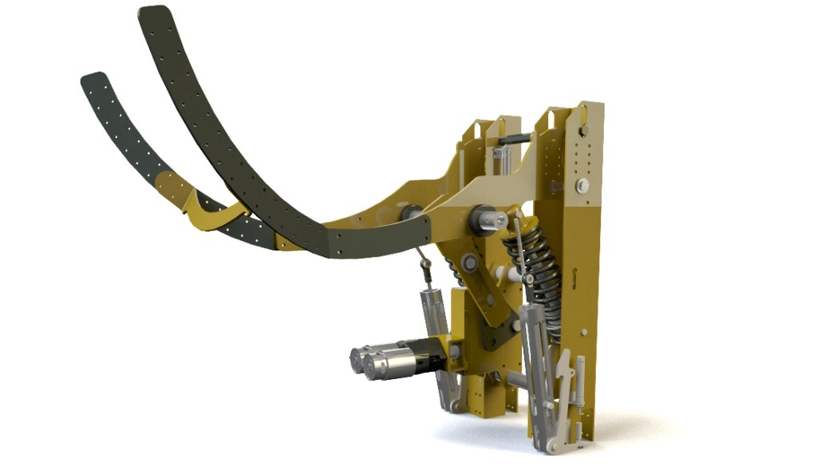
The Catapult
What sources of energy loss do we expect?
2014 Funk Cannon, FIRST 846

Slide 29
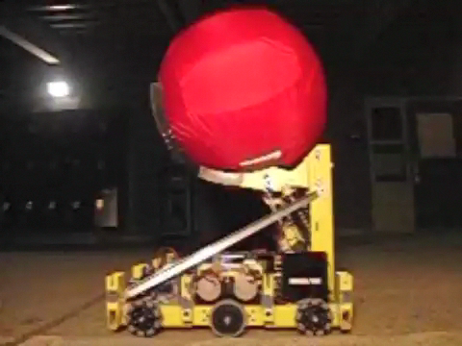
Energy Losses in a Catapult

Slide 30
Energy Losses in a Catapult
Observed Losses:
Residual energy in arm
Deformation of projectile
Transfer of energy to robot frame
2014 Funk Cannon, FIRST 846

Slide 31
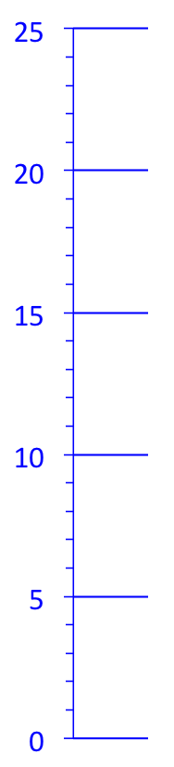
Ball Drop Loss & Efficiency
Initial Energy:
Final Energy:
Drop Efficiency:
h_{i}
h_{f}
Notes:
Video tape drop with scale on wall. Measure bottom of ball. Try at different heights to confirm energy efficiency is consistent.

Slide 32
Computing the Required Energy for a Catapult Spring
Determining Required Energy
Compute ball’s energy from trajectory
Divide by “ball drop efficiency” to get the launch energy
Add residual energy of arm Use CAD to compute I_{Arm}, or do estimate manually.
Add energy imparted to robot frame Did not consider in design, except to make all wheels on ground.; May be hard...
Best guess. This is clearly wrong if efficiency is small.
2014 Funk Cannon, FIRST 846
Notes:
If efficiency is low, computing the launch energy will be wrong. More thought is needed in this case on how to estimate the loss. –dg.

Slide 33
The Kicker
2010 BreakAway
Ball must remain outside robot.

Slide 34
Kicker – Compute Energies
Calculate trajectory and launch energy
Estimate impact energy loss ( bounce test)
Solve energy / momentum equations
Consider choosing the mass of hammer to equal the ball’s mass. (more on this later...) See: Newton’s Cradle

Slide 35
The Kicker
Transfer of Energy from Spring to Hammer
Stored energy:
...for a Torsion Spring
Kinetic energy:
Notes:
We model trajectory as in first case. Let’s consider energy in hammer first, then consider impact. The force profile of the spring does not matter.

Slide 36
Linear to Angular
Hammer’s momentum may be modeled as Angular momentum
Linear energy:
...for a Torsion Spring
Notes:
This will allow us to add in other masses in the system, like the Hammer’s handle.

Slide 37
Linear to Angular
Now we can include the effects of the hammer’s arm
...for a Torsion Spring
Notes:
This will allow us to add in other masses in the system, like the Hammer’s handle.

Slide 38
Linear to Angular
Equating the spring energy to the hammer’s kinetic energy:
Since:
...for a Torsion Spring
Notes:
This will allow us to add in other masses in the system, like the Hammer’s handle.

Slide 39
Angular back to Linear
And we can bring this all back to the linear system...
Linear momentum, p
From before
...for a Torsion Spring
Notes:
This will allow us to add in other masses in the system, like the Hammer’s handle.

Slide 40
Kicker – The Collision
We Know:
Energy required for ball trajectory
Hammer speed & Momentum as a function of Spring Energy
We need:
Energy & Momentum transfer at time of Kick

Slide 41
Angular – Linear Parallels
From before
Linear momentum, p
...for a Torsion Spring
Notes:
This will allow us to add in other masses in the system, like the Hammer’s handle.

Slide 42
Newton’s Law (paraphrased)
1) ....an object either is at rest or moves at a constant velocity, unless acted upon by an external force.
2) F = ma (acceleration is proportional to force, and inversely proportional to mass)
3) When one body exerts a force on a second body, the second body simultaneously exerts a force equal in magnitude and opposite in direction to that of the first body.
From (2) and (3) we can show conservation of momentum.

Slide 43
Conservation of Momentum
(2)
A
B
(3)
For any interval Δt,

Slide 44
Conservation of Momentum
A
B
During collision, momentum is added to B and removed from A.
A
B
A
B

Slide 45
Conservation of Energy vs Conservation of Momentum
Momentum:
Kinetic Energy:
For conservation of Total Energy,
we must account for the energy absorbed during the impact (if any).
Total Energy:
Total energy is conserved in the isolated system, but kinetic energy is not.
Notes:
Which is conserved?

Slide 46
Extreme case: Elastic Collision
Momentum:
set (4)=(5)
Energy:
Introduce α:
(1)
(2)
(2)
Rearrange:
(3)
(4)
Divide (3) by (4):
(5)

Slide 47

Newton’s Cradle – Elastic Collisions
http://onlyhdwallpapers.com

Slide 48
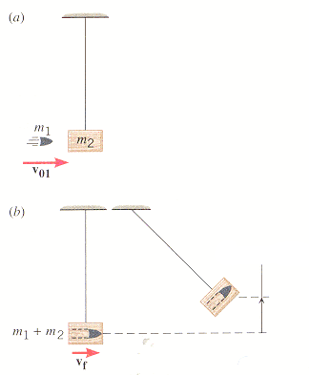
Extreme case: Completely Inelastic Collision
Momentum:
(1)
Ballistic test to measure bullet speed
Completely Inelastic:
(2)
Introduce α:
Substitute:
www.chegg.com

Slide 49
Kicker – conclusion for elastic case
We can bound the collision between Elastic and Inelastic cases.
If the ball we are kicking has a high return bounce, we can model the collision as elastic with reasonable confidence.
In this case, choosing the equivalent mass of the kicker to equal the mass of the ball will stop the kicker on impact. This will result in a minimum of wasted energy.
Then we can simply determine the required spring energy as the ball energy / efficiency from the bounce test.
With a working machine, the kicker-ball collision can be better analyzed, and the design may be iterated.
Notes:
This is inconsistent, since if we don’t have 100% efficient bounce test, then we can’t have a 100% elastic collision. If the result is not satisfactory, we must better characterize the impact.

Slide 50
Double Wheel Shooter
Two methods of launch:
Inelastic collision: Final surface speed of Launch wheels =

Slide 51
Double Wheel Shooter
Two methods of launch:
Inelastic Collision:
Friction Drive:
Notes:
Inelastic collision uses less energy

Slide 52
Double Wheel Shooter
Inelastic Collision:
Friction consistency not as important; Final speeds must match.
Friction Drive:
Wheel speed accuracy not as important
Energy loss on wheels are larger
Notes:
Friction Drive uses more energy; If friction force is the same, then launch wheel will travel a larger angle than the Inelastic collision.

Slide 53
Double Wheel Shooter - Inelastic
Initial Momentum:
Wheel Momentum
Notes:
Friction Drive uses more energy; If friction force is the same, then launch wheel will travel a larger angle than the Inelastic collision.

Slide 54
Double Wheel Shooter - Inelastic
Momentum Conservation
Note: Shot distance will start falling when wheels start failing to match projectile speed.
Notes:
If increasing wheel speed results in shorter shot, then wheels are not in contact at the end of the shot; Much like a skidding car.

Slide 55
Single wheel launchers
Projectile rolls along one edge
If launch velocity is V,
...how fast does drive wheel need to turn?

Slide 56
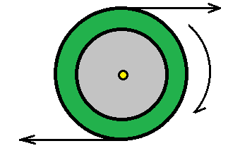
And Here’s the Math…
Rotation Motion Only
V
0
-V

Slide 57
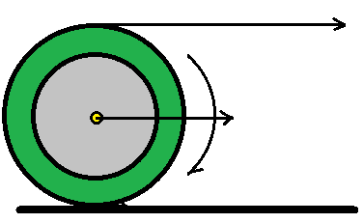
Rotational and Translational Motion
V + V = 2V
0 + V = V
-V + V = 0

Slide 58
Momentum Transfer in Launcher

Slide 59
Force to Accelerate in Distance
If we accelerate our projectile over a distance d, to reach a launch velocity V, how much constant force must applied to the projectile?
Our Example:
g=10m/s²; back of envelope calculation...

Slide 60
Squeeze Force to Accelerate in Distance
If we must apply a force F to accelerate our projectile, how much force must we apply to the rim or surface of our projectile?
A high friction surface μ>1, can reduce the grip force

Slide 61
Additional Topics
Time to Speed
Improving contact time (wheel shooter)
zero force on backing plate (single wheel shooter)

Slide 62
Throwing Balls and other stuff
Understand the physics!
Separate the well known problems
trajectories
momentum and energy transfer
...from variants.
inconsistent balls ( shape, weight, compliance...)
inconsistent ball paths thru machine
:
and Build a Better Machine!

Slide 63
Throwing Balls and other stuff
David Giandomenico December 13, 2014

Slide 64
Specify the projectile trajectory
Need to know speed & spin requirements of the shooter
1) Specify the projectile’s trajectory (height, distance, entry angle etc.)
2) Compute launch velocity
3) Calculate energy requirements of projectile
Start shooter design:
1) Select a candidate design
2) Analyze momentum & energy to determine speeds
3) Consider grip forces on projectile
4) Parts selection ( e.g. wheel selection )
5) Gear-motor selection
Iterate
Scope of Talk

Slide 65
Specify the projectile trajectory
Need to know speed & spin requirements of the shooter
1) Specify the projectile’s trajectory (height, distance, entry angle etc.)
2) Compute launch velocity
3) Calculate energy requirements of projectile
Start shooter design:
1) Select a candidate design for launcher
2) Analyze momentum & energy to determine speeds
3) Consider grip forces on projectile
4) Parts selection ( e.g. wheel selection )
5) Gear-motor selection
Iterate
Scope of Talk

Slide 67
Angular Momentum
Moving momentum in our launch wheel to our projectile.

Slide 68
Torque for a particle of mass m
Torque for a particle m
a more mathematically rigorous approach:
Notes:
The more rigorous approach allows a general computation, without having to decompose the normal and in-line components of forces.

Slide 69
System of particles
Now, let’s consider a system of particles...
...or a mass M of some shape:

Slide 70
Moment of Inertia of a Disk
Substitute the mass (by inspection):
Integrate shells of 2πrh:

Slide 71
Angular Momentum
following the same math as before

Slide 72
Converting Angular to Linear Momentum

Slide 73
Projectile Momentum

